Slide 1

DANIEL ESEME
S/N 100841468
DATA1200 - ASSIGNMENT 4 - CLUSTERING
PROF: SAM PLATI

Slide 2
RATIONAL STATEMENT
To understand how clustering techniques are used for K-Means model. Using the ‘leuanalysis’ dataset to carryout this experiment.

Slide 3
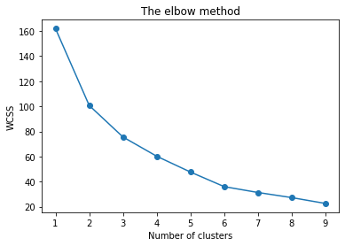
Identify and Justify the number of clusters required to optimize a K-means Model by using both the Elbow and Silhouette Methods.
ELBOW METHOD
The number of clusters needed to optimize a K-means Model is (6), as can be seen from the plotting, where the slope takes a bend knee to indicate.
Last point, possible overlap or non-spherical clusters

Slide 4
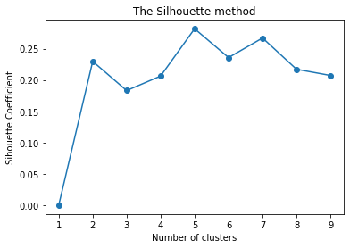
Identify and Justify the number of clusters required to optimize a K-means Model by using both the Elbow and Silhouette Methods.
SILHOUETTE METHOD
To determine the number of clusters needed, I will look at the maximum point on the plot, which stands at (5) for the right number of clusters required. At (5) the K-means model will be optimized
Output does not show negative but comes at zero(0.28) showing an overlap in the dataset

Slide 5
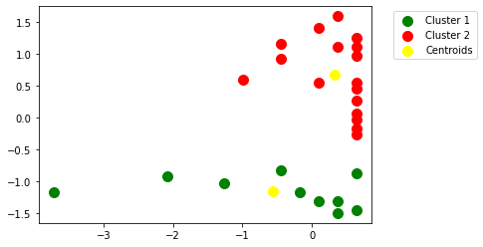
Create and Present a two (2) cluster visualization of the dataset

Slide 6
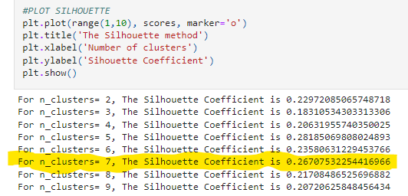
Identify and Explain two (2) insights from the newly created clusters in 2 d)
The Centroids are found somewhat in the centre of cluster 1 and cluster 2. the groupings and separations are distanced with identification
Optimized based on 2 clusters
Observing the newly created clusters, n_cluster should be 7

